Slide 1
EV Infrastructure
Planning & Economic Development
Amy Hodges, Principal Air Quality Planner
June 15, 2023
North Central Texas Economic Development District
Notes:
Add RTC logo if necessary

Slide 2
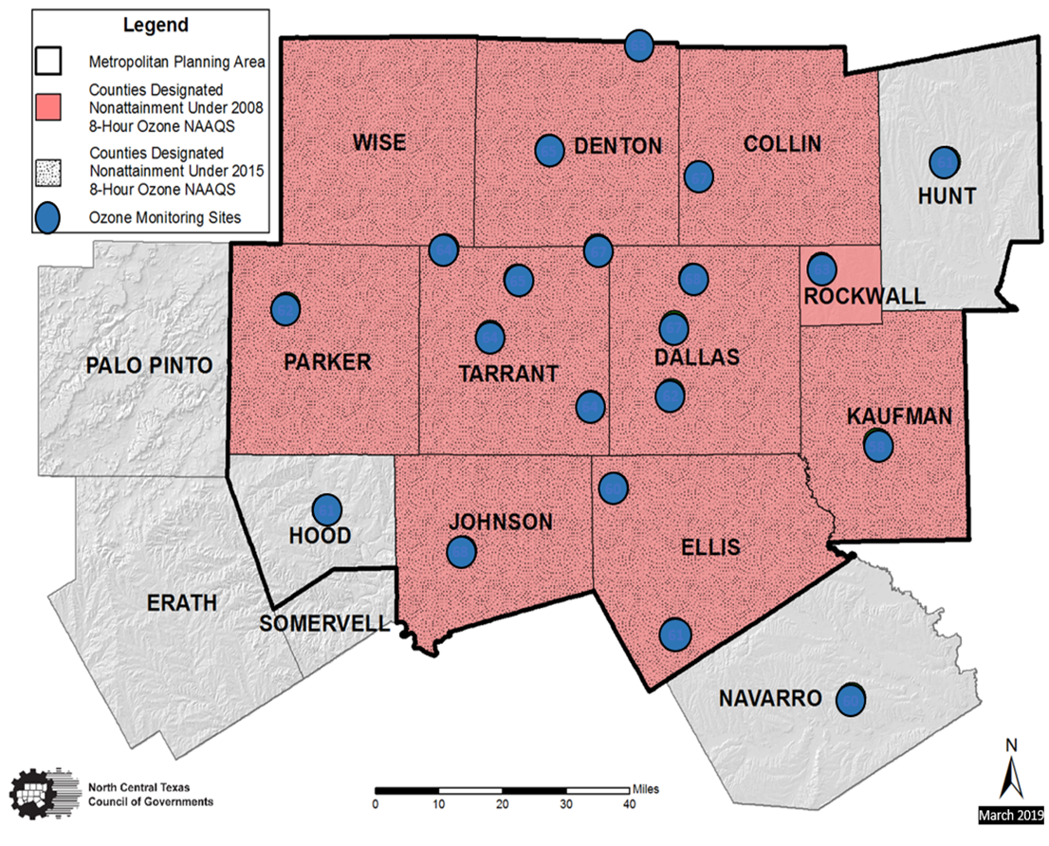
Who We Are
Regional Planning Agency
Metropolitan Planning Organization (MPO)
Local Clean Cities Coalition
2

Slide 3
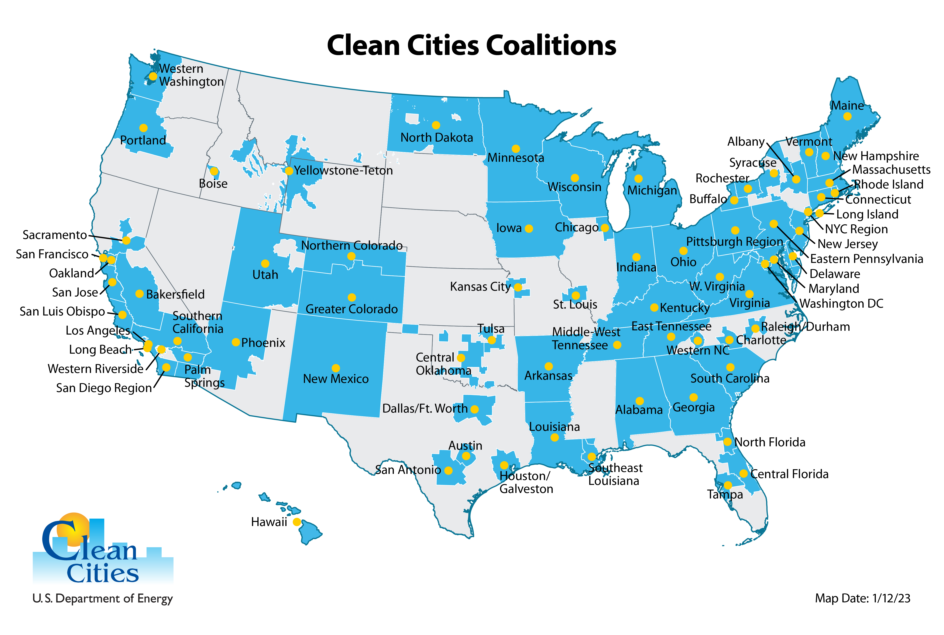
National Network of Clean Cities Coalitions
More than 75 Clean Cities coalitions with thousands of stakeholders, representing ~80% of U.S. population
Designated by the Department of Energy
EV Infrastructure Planning & Economic Development

Slide 4
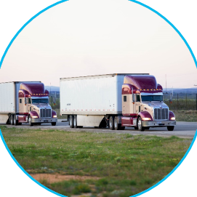
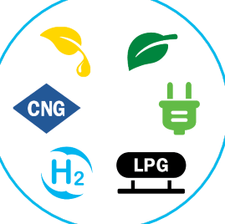
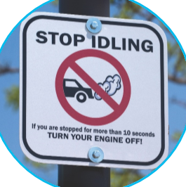
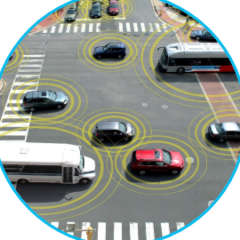
Clean Cities Portfolio
Light-, Medium-, and Heavy-Duty Vehicles
Alternative and Renewable Fuels and Infrastructure
Idle Reduction Measures and Fuel Economy Improvements
New Mobility Choices and Emerging Transportation Technologies
EV Infrastructure Planning & Economic Development

Slide 5
What We Do
Funding Support
Assist with Navigating Programs and Developing Grant Applications
Administer Funding
Technical Assistance
Maintain and Analyze Data
Hold Webinars, Workshops, Peer Exchange
Develop Best Practices and Template Resources
Planning the Future
Alternative Fuel Corridors
Texas EV Charging Plan
ZEV Infrastructure
Organic Waste to RNG Feasibility Study
Raising Awareness
Facilitating Relationships
National Drive Electric Week
Fleet Recognition
Success Stories and
Community Events
5

Slide 6
Key Focus Areas and Goals
Fleet/Driver Guidance and Planning
- Support Transition to Zero Emission Vehicle (ZEV) and Other Alternative Fuel Technologies
- Assist Deployment of Clean Vehicle Technologies by Identifying, Promoting, and Providing Funding
Infrastructure Planning & Readiness
- Increase Equitable Access to EV Charging Infrastructure
- Build Publicly-Accessible Infrastructure Network to Support ZEV Transition in Medium- and Heavy-Duty Sector
- Ensure Local Governments are Informed and Prepared to Support Local EV Adoption
- Reduce Barriers, Delay, and Cost in Local Infrastructure Development
Energy Integration
- Minimize Negative Electric Grid Impacts Associated with Transportation Electrification
- Increase Local Availability of Renewable Fuels (electricity, natural gas, hydrogen, biodiesel)
- Improve Resilience against Fuel/Energy Interruptions
EV Infrastructure Planning & Economic Development

Slide 7
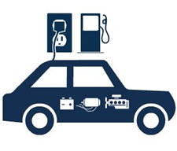
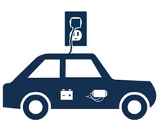
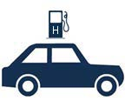
TYPES OF ELECTRIC VEHICLES (EV)
Plug-In Hybrid Electric Vehicles (PHEV)
Powered by an electric motor and engine
Uses electric vehicle supply equipment (EVSE) to charge the battery
All-Electric Vehicle (EV)
Powered by an electric motor
Uses EVSE to charge the battery
Fuel Cell Electric Vehicle (FCEV)
Powered by compressed hydrogen and an electric motor
Uses hydrogen fuel to charge the battery; does not use EVSE

Slide 8
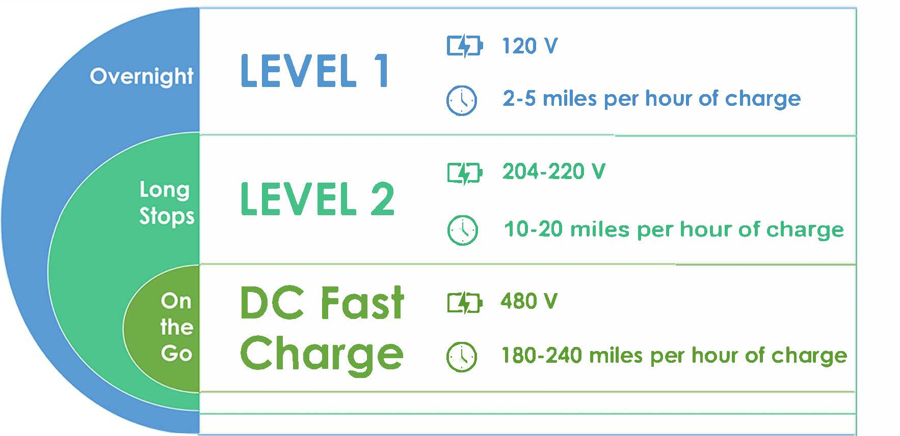
TYPES OF EV CHARGING AND INFRASTRUCTURE

Slide 9
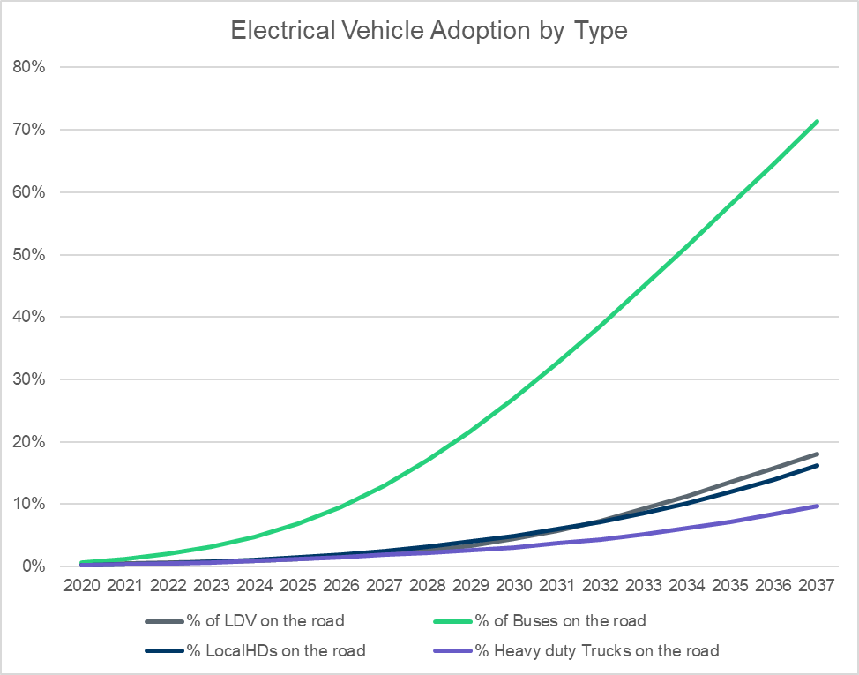
National Electric Vehicle Trends
Plug-In Vehicle Sales in March 2023 Were Up 25.2% From Sales in March 2022, Capturing 7.37% of Total Light-Duty Sales in March 2023.¹
EV Fleet Has Doubled in Past 4 Years²
Bloomberg New Energy Finance Suggests EVs ~20-30% of New Sales by 2025³
Executive Order Aims for Half of All New Vehicles Sold in 2030 be Zero-Emission⁴
Source: Electric Reliability Council of Texas (ERCOT) Long-Term System Assessment, https://www.ercot.com/gridinfo/planning. Uses an adjusted (delayed) forecast from Bloomberg
New Energy Finance Electric Vehicle Outlook (https://about.bnef.com/electric-vehicle-outlook/).
¹Argonne National Laboratory (Light Duty Electric Drive Vehicles Monthly Sales Updates | Argonne National Laboratory (anl.gov)); ²EPA Automotive Trends Report (https://www.epa.gov/automotive-trends); ³ Zero-Emission Vehicles Factbook (https://assets.bbhub.io/professional/sites/24/BNEF-Zero-Emission-Vehicles-Factbook_FINAL.pdf);
⁴ White House News Room (https://www.whitehouse.gov/briefing-room/statements-releases/2021/08/05/fact-sheet-president-biden-announces-steps-to-drive-american-leadership-forward-on-clean-cars-and-trucks/)

Slide 10
Electrification Transition Goals of Manufacturers (% of Sales) | Data as of 7/8/2022
FCEV – Fuel Cell Electric Vehicle PHEV – Plug-In Hybrid Electric Vehicle ICE – Internal Combustion Engine
% of sales that do not use ICEs
OEM has phased out ICEs in a region other than the United States
*This list is not comprehensive, and manufacturers are not endorsed by NCTCOG
100% by 2026 (Only New Models)
100% by 2033
Electrification plans includes hybrids or only applies to new models
Carbon neutrality goal
Audi
BMW
Ford
General Motors
Honda
Hyundai
Kia
Mercedes-Benz
Nissan
Stellantis
Subaru
Toyota
Volkswagen
Volvo
Signed UN COP26
(No ICE Sales by 2035)
50%
100% (Aspirational)
40% (Includes FCEVs)
80% (Includes FCEVs)
100% (Includes FCEVs)
30% (Includes FCEVs)
80% (Includes FCEVs)
40% (Includes Hybrids)
50%
100% (In Select Markets)
40% (100% New Models)
50% in US (100% in Europe)
40% (Includes Hybrids)
15% (70% with Hybrids)
20%
50%
100%
50%
100%
NCTCOG/
DFW Clean
Cities
2025
2030
2035
2040
2045
2050

Slide 11
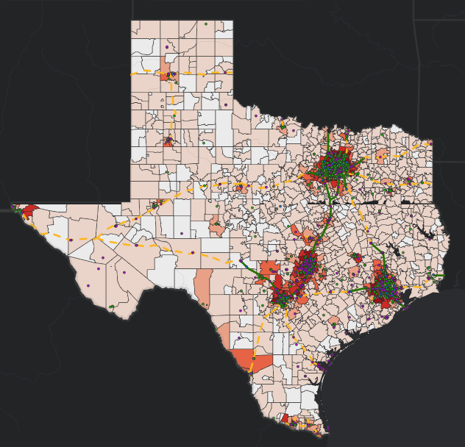
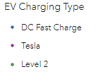
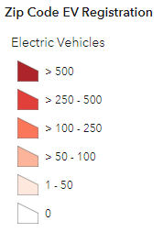
Texas Data And Trends
Electric Vehicle (EV) Registration Data
www.dfwcleancities.org/evnt -> EVs and Texas
Charging Station Dashboard
https://txdot.mysocialpinpoint.com/tx_ev_plan
Charging Sites Statewide (includes Tesla):
2,644 Level 2
343 DC Fast
 | May 2022 | May 2023 | Increase
Texas | 125,418 | 191,690 | 53%
DFW | 44,847 | 69,996 | 56%
11

Slide 12
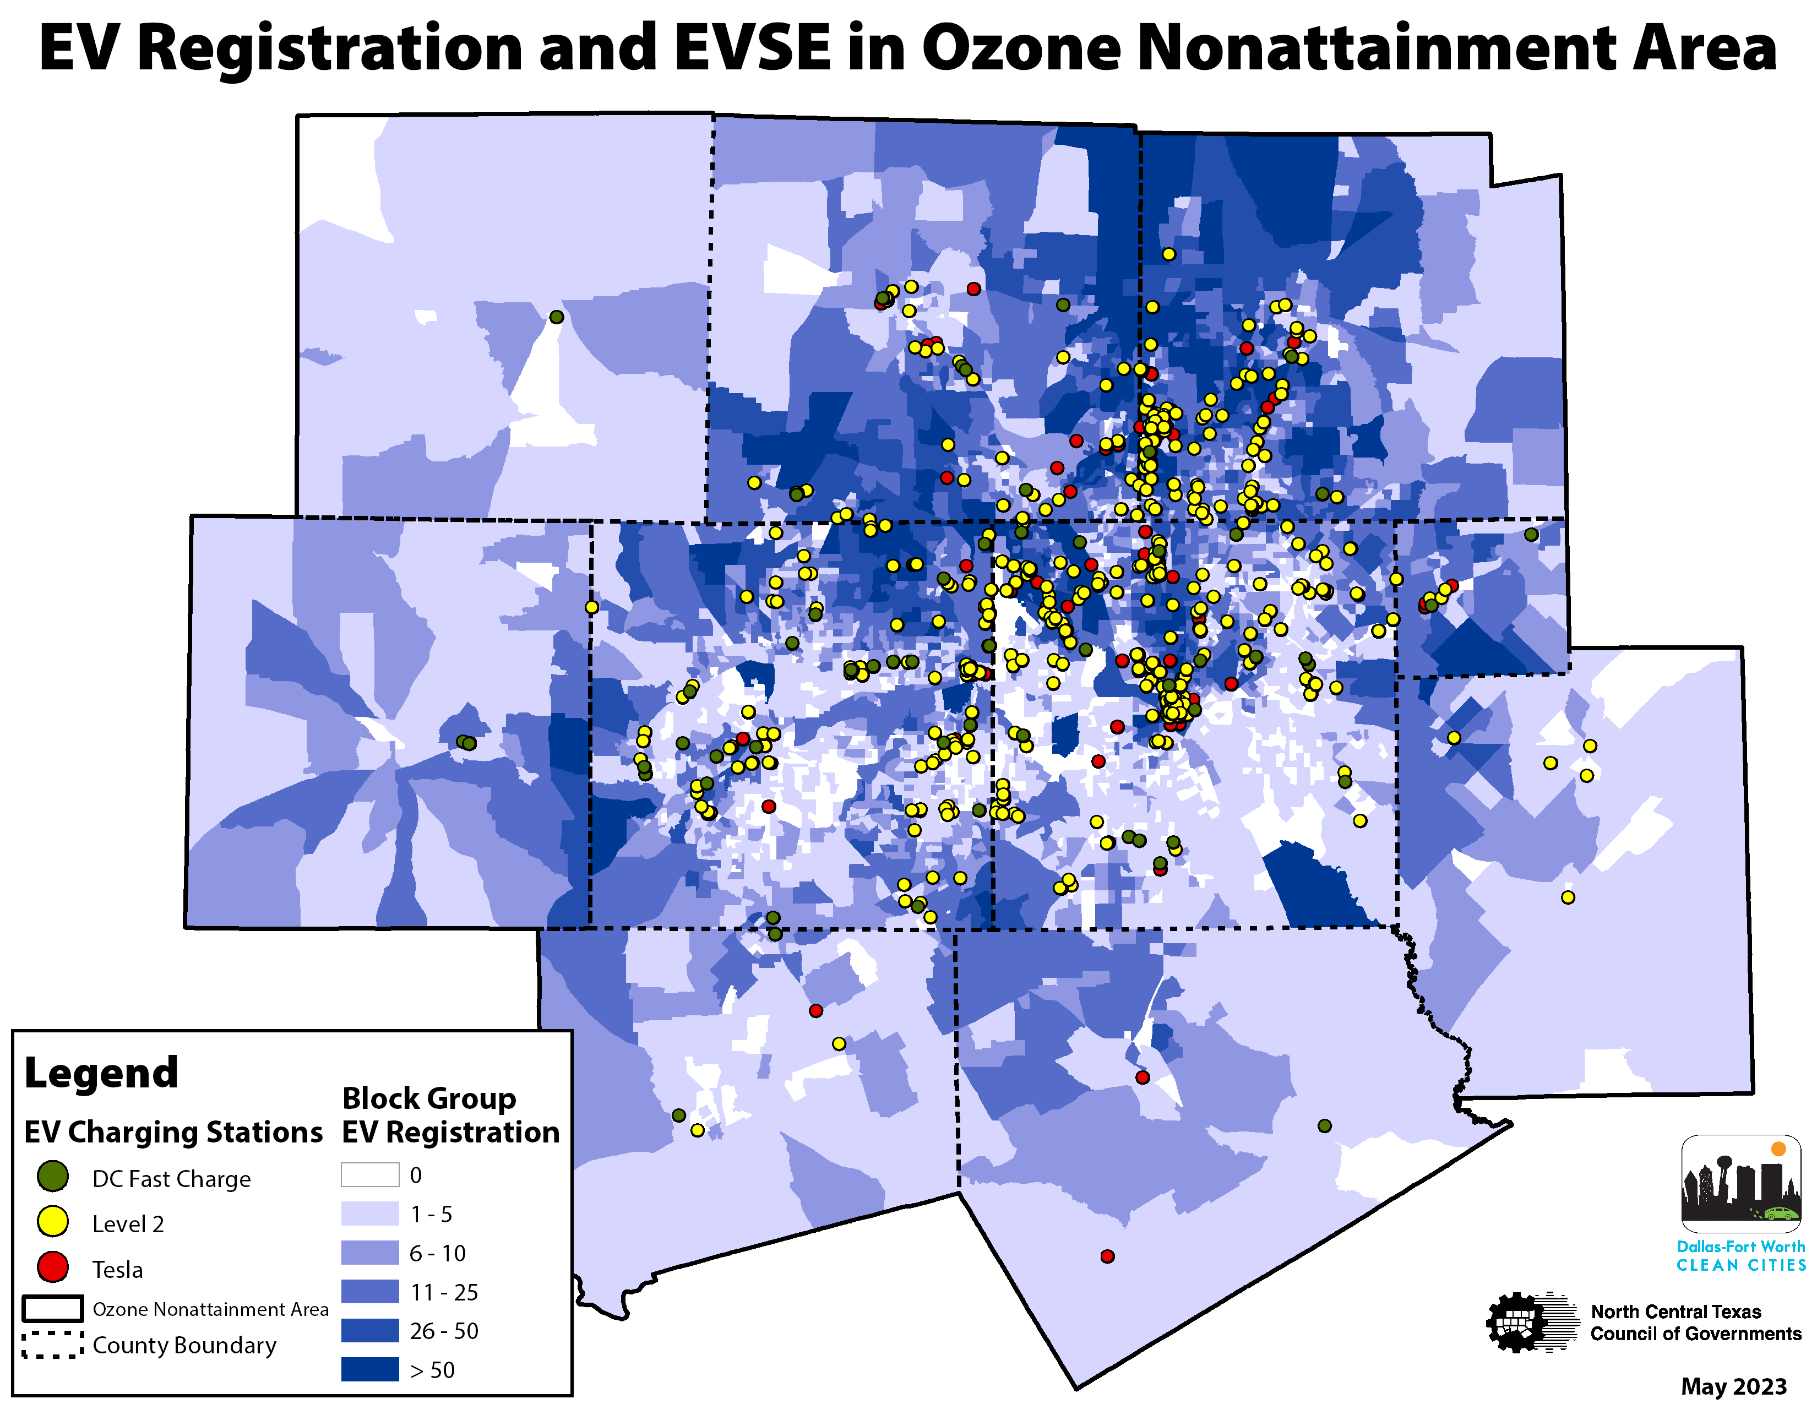
EV Adoption and Infrastructure Availability
County | Level 2 Plugs* | DC Fast Charge Plugs*
Collin | 238 | 6
Dallas | 574 | 20
Denton | 98 | 15
Ellis | 0 | 4
Johnson | 5 | 2
Kaufman | 12 | 0
Parker | 4 | 2
Rockwall | 9 | 5
Tarrant | 354 | 26
Wise | 2 | 1
*As of May 2023; Excludes Tesla Stations
12

Slide 13
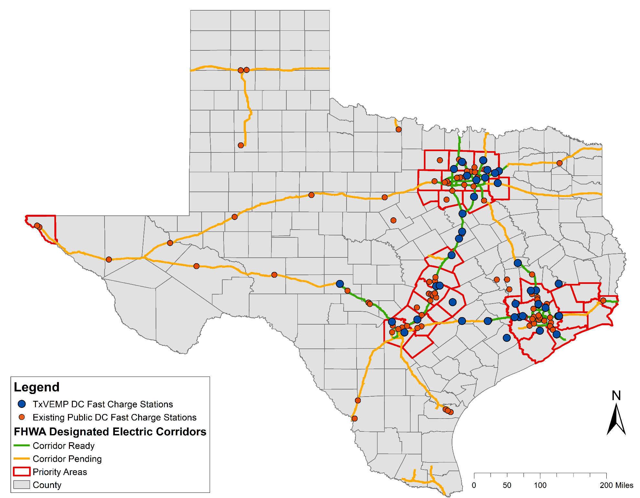
DC Fast Charging Across Texas
Texas Volkswagen Environmental Mitigation Program:
~$20.9 Million DC Fast Charging
170 Plugs at 41 Sites
96% of Funds to Fuel Retailer Sites
*Existing Station Data from Department of Energy Alternative Fueling Station Locator as of May 2023

Slide 14
NEVI Formula Funding Impacts to Texas
Texas Department of Transportation (TxDOT) to Receive and Administer ~$408 Million Over Five years to Deploy EV Charging
Statewide Infrastructure Deployment Plan Required
Provide at Least One Qualifying Station Every 50 Miles Along Designated Corridors
Be Within One Mile of Designated EV Corridor Exit
Include at Least Four CCS-type DC Fast Charge Connectors, Minimum 150kW Power Output at All Times
Minimum Site Power Capacity 600 kW
Restrict Funding to Designated EV Corridors until Demonstration that all Designated Highways are “Saturated” With Qualifying Stations
14

Slide 15
Highlights Of Texas EV Charging Plan
Posted at https://txdot.mysocialpinpoint.com/tx_ev_plan
Year 1 | Install DC Fast Chargers Along Alternative Fuel Corridors (Estimated 55 Stations Statewide; $48.51M Federal)
Years 2-5 | Work with Counties and Small Urban Areas to Install DC Fast Charge Sites In/Near County Seats (Estimated 190 Locations, $159.7M Federal) Work with MPOs to Identify Locations and Appropriate Combination of Charging Sites (Number Locations TBD, Estimated $198.92M Federal)
Throughout | Collect Data
For Reference: 343 DC Fast Charging Sites Statewide as of June 14, 2023
Status Report on FHWA Alternative Fuel Corridors and the Bipartisan Infrastructure Law
15

Slide 16
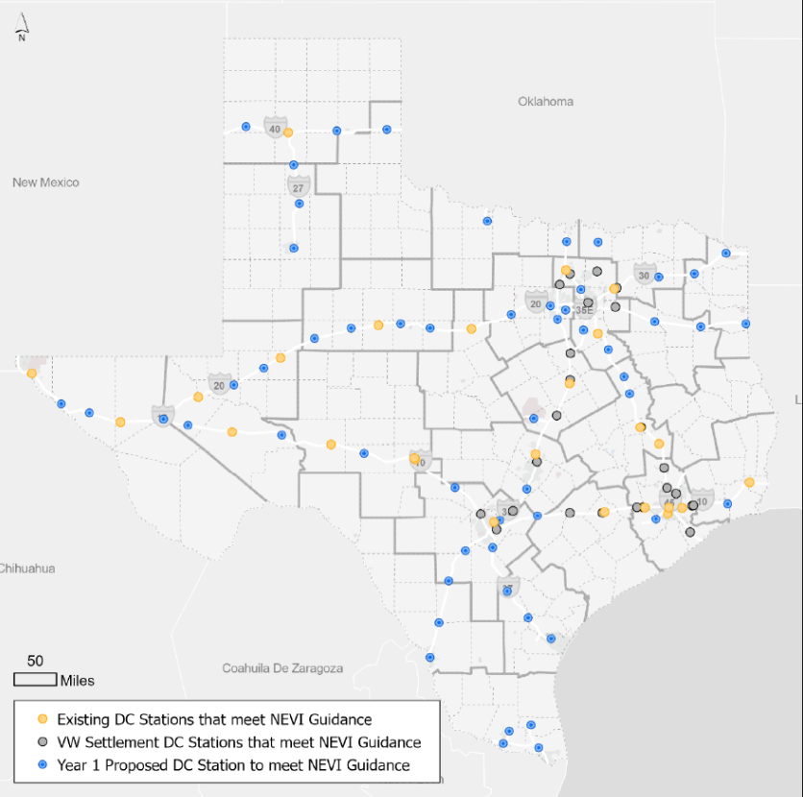
Texas EV Charging Plan Impacts To NCTCOG Region
Phase 1:
Install DC fast charging in recommended study areas along designated corridors
“Dark Blue Dots”
5 within the 12-County Metropolitan Planning
Area (MPA)
1 Each in Navarro and Palo Pinto Counties
Objective is 1 station with at least 4 connectors every 50 miles
Competitive grant program opening soon
www.txdot.gov/projects/projects-studies/statewide/texas-electric-vehicle-planning-03-22-22.html
Source: TxDOT Texas EV Charging Plan Story Map: Texas Electric Vehicle Infrastructure Plan (arcgis.com)
16

Slide 17
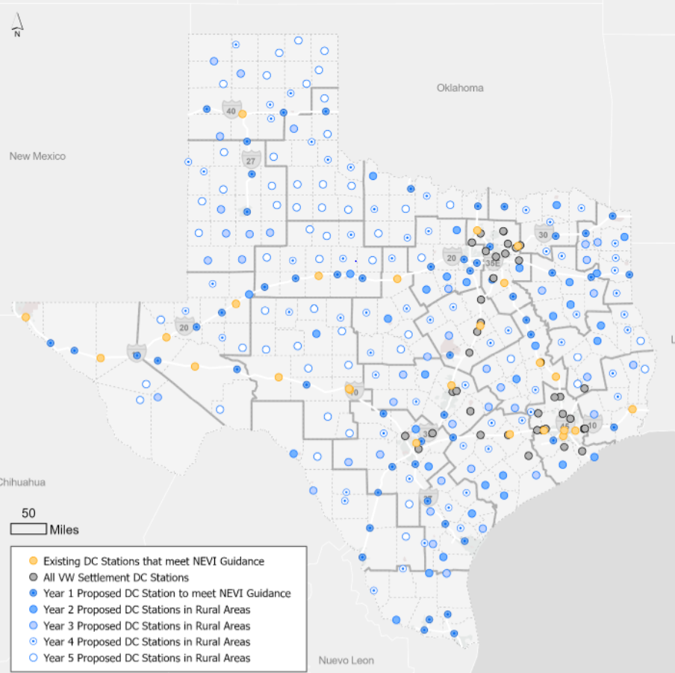
Texas EV Charging Plan Impacts To NCTCOG Region
Phase 2: (2 Parallel Approaches)
Build Infrastructure in Rural Areas, Focused on County Seats
“Other Blue Dots”
Work With Metropolitan Planning Organizations (MPOs) to Add More Infrastructure in Urbanized Areas (Add Blue Dots!)
MPOs Recommend Type and Locations
NCTCOG 12-County MPA: $64.5 Million Allocation
www.txdot.gov/projects/projects-studies/statewide/texas-electric-vehicle-planning-03-22-22.html
Source: TxDOT Texas EV Charging Plan Story Map: Texas Electric Vehicle Infrastructure Plan (arcgis.com)
17

Slide 18
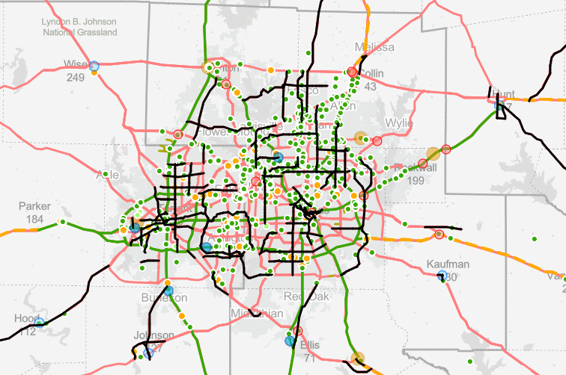
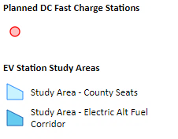
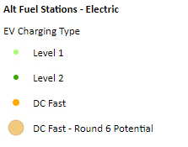
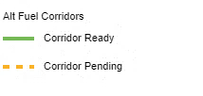
Preliminary NCTCOG Approach to Phase 2
Step 1: Identify priority “secondary highways” on the National Highway System; Recommend study areas to meet NEVI corridor criteria
High-Volume Corridors within Urbanized Areas
Major Inter-Regional Connectors (e.g., US 287, US 175)
Step 2 (pending availability of funds): Identify study areas to address “Community Charging” needs
Image Source: TxDOT Statewide Planning Map, https://www.txdot.gov/apps/statewide_mapping/StatewidePlanningMap.html
Status Report on FHWA Alternative Fuel Corridors and the Bipartisan Infrastructure Law
18

Slide 19
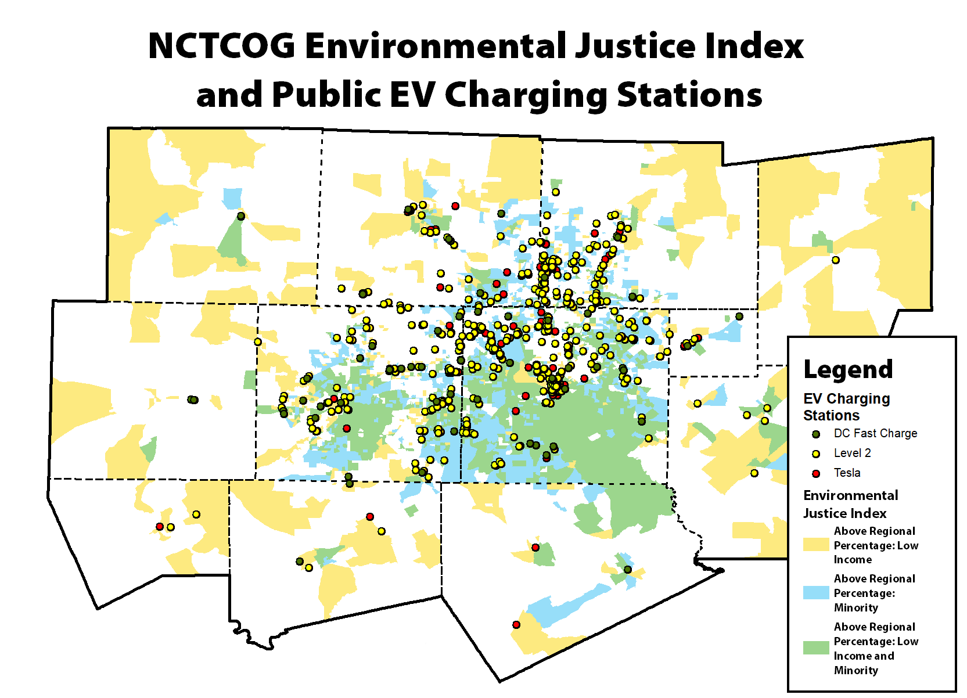
Recommendations for Community Charging
Engage the community, understand needs & wants
Ensure Justice40 objectives are met
Fill in gaps left by existing stations and planned infrastructure (e.g., NEVI, Texas Volkswagen Environmental Mitigation Program)
Identify goals (e.g., charger within x miles, x minutes, etc.)
Ensure stations along major travel corridors
Focus on areas that are still underserved
Engage with multi-family properties and major
employers
Consider grid resilience and how EVs can contribute
Update regulatory processes to streamline investments
Establish EV-ready building codes
Review/update permitting processes

Slide 20
Identifying Community Needs
Poverty Population
Minority Population
Households with 1 or More Cars
Proximity to Public Chargers
Public Transit Usage
Housing Age
Single vs. Multi Family Housing
Factors to Consider Equity, Environmental Justice, and Highest Need
Others?

Slide 21
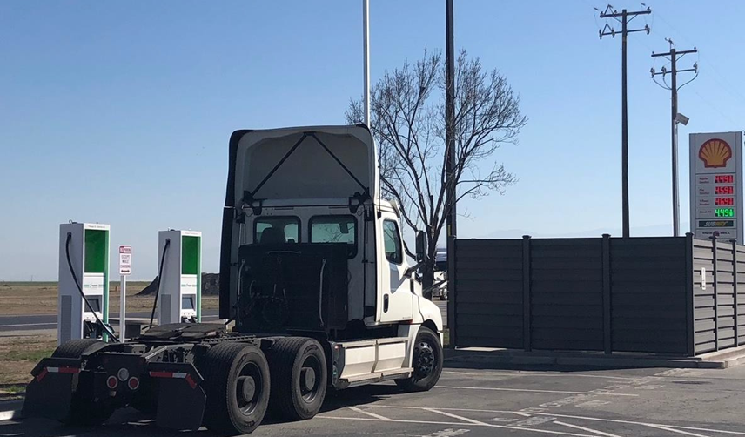
Recommendations for Medium- and Heavy-Duty
Enabling freight transition away from diesel can reduce diesel exposure among communities that live and work near freight-heavy areas
Consider integrating charging with other freight needs
Identify areas where trucks queue/linger
Integrate with truck parking
Engage with warehouse and freight-oriented developers
Incorporate medium- and heavy-duty when building other EV infrastructure, where appropriate
Pull-through capabilities
Site layouts to accommodate large vehicles
Engage with utility provider to plan for electricity needs
Photo source: Portland General Electric & Daimler Truck

Slide 22
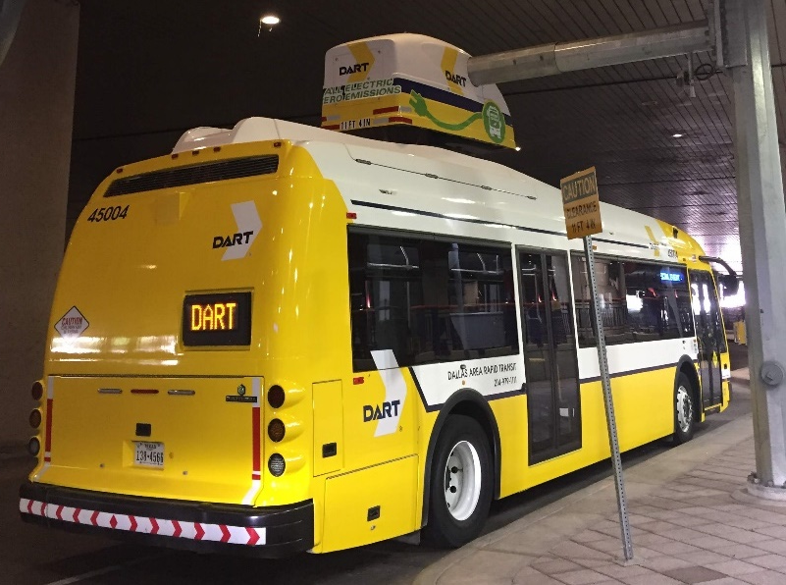
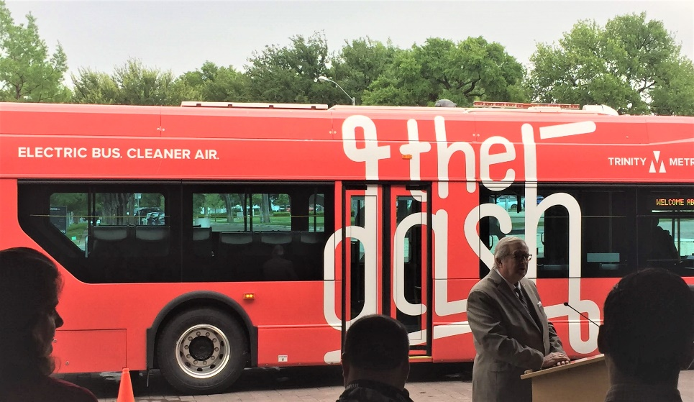
Medium- and Heavy-Duty Projects
Public Sector:
Transit Buses: DART and Trinity Metro
School Buses: Everman ISD
Refuse Hauler: City of Plano (funded)
Private Sector:
$3.43 Million Awarded by NCTCOG to
22 Electric Replacements
Terminal Tractors
Short Haul Trucks
Airport Ground Support Equipment
Source: NCTCOG
Source: NCTCOG
22

Slide 23
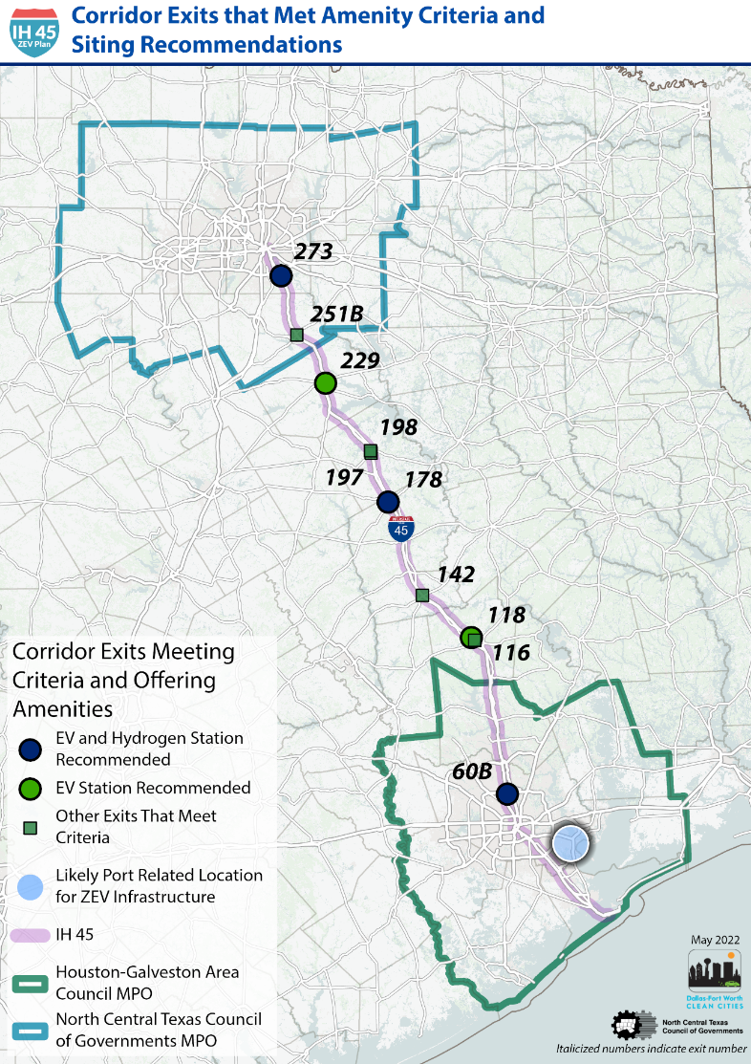
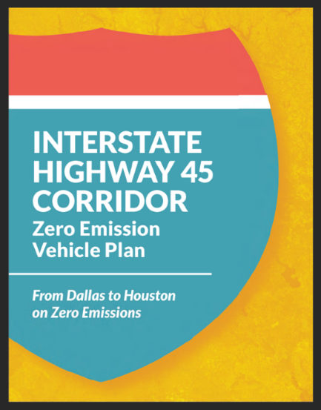
Medium- and Heavy-Duty
Infrastructure
Goal:
Build Publicly-Accessible Infrastructure Network to Support Zero Emission Vehicle (ZEV) Transition in Medium- and Heavy-Duty Sector
Key Activities:
Publicize IH 45 ZEV Corridor Plan
Completed in August 2022
North Central Texas Council of Governments - IH 45 Corridor Zero Emission Vehicle (nctcog.org)
Support/Partner on Implementation of IH 45 Recommendations
Develop Additional Corridor Plans
Collaborate with TxDOT to Nominate Alternative Fuel Freight Corridors
EV Infrastructure Planning & Economic Development

Slide 24
Charging and Fueling Infrastructure Program
Established by the Bipartisan Infrastructure Law to deploy publicly accessible electric vehicle (EV) charging and other alternative fueling infrastructure in communities and along designated Alternative Fuel Corridors (AFC)
For Fiscal Year (FY) 2022 and FY2023, $700M split evenly in two funding categories:
Corridor Program ($350M Available)
Minimum: $1,000,000
No maximum
Federal share: up to 80 percent of the total project cost
Eligible entities that contract with a private entity must include that the private
entity will be responsible for the non-Federal share of the project cost
https://www.fhwa.dot.gov/environment/cfi/
Community Program ($350M Available)
Minimum: $500,000
Maximum: $15,000,000

Slide 25
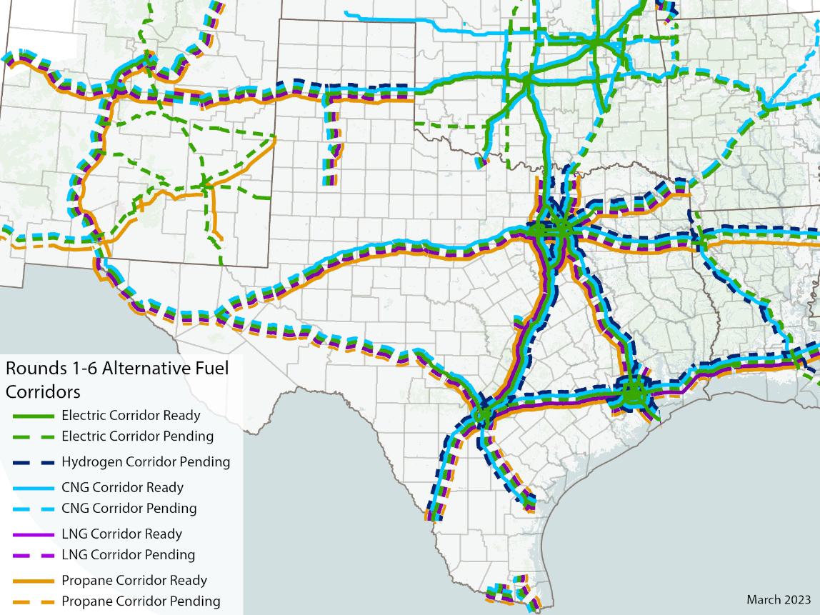
Corridor Program: Eligibility and Need
Designed to build EV charging or alternative fueling infrastructure along designated Alternative Fuel Corridors (AFC)
Opportunity to Start Deploying Recommendations from IH-45 Zero Emission Vehicle Infrastructure Plan
Battery Electric for Local Freight
Hydrogen Fuel Cell Electric for Long Haul Freight
Medium/Heavy-Duty Vehicle Impacts:
Only ~5 % of Miles Traveled but Nearly ~40% of Nitrogen Oxides (NO_{X})

Slide 26
CFI Corridor Program: Approach
Call for Partners opened on March 6, 2023
Establish public-private partnerships between NCTCOG and project teams
Scope zero-emission vehicle (ZEV) infrastructure projects to support medium- and heavy-duty ZEVs
Publicly accessible electric charging and/or hydrogen refueling equipment
Located along a designated AFC for the proposed fuel
Received 12 proposals by deadline of April 7, 2023
Selected top proposals and coordinated with Proposal Teams to Refine Project Scopes for Federal Highway Administration (FHWA) Proposal

Slide 27
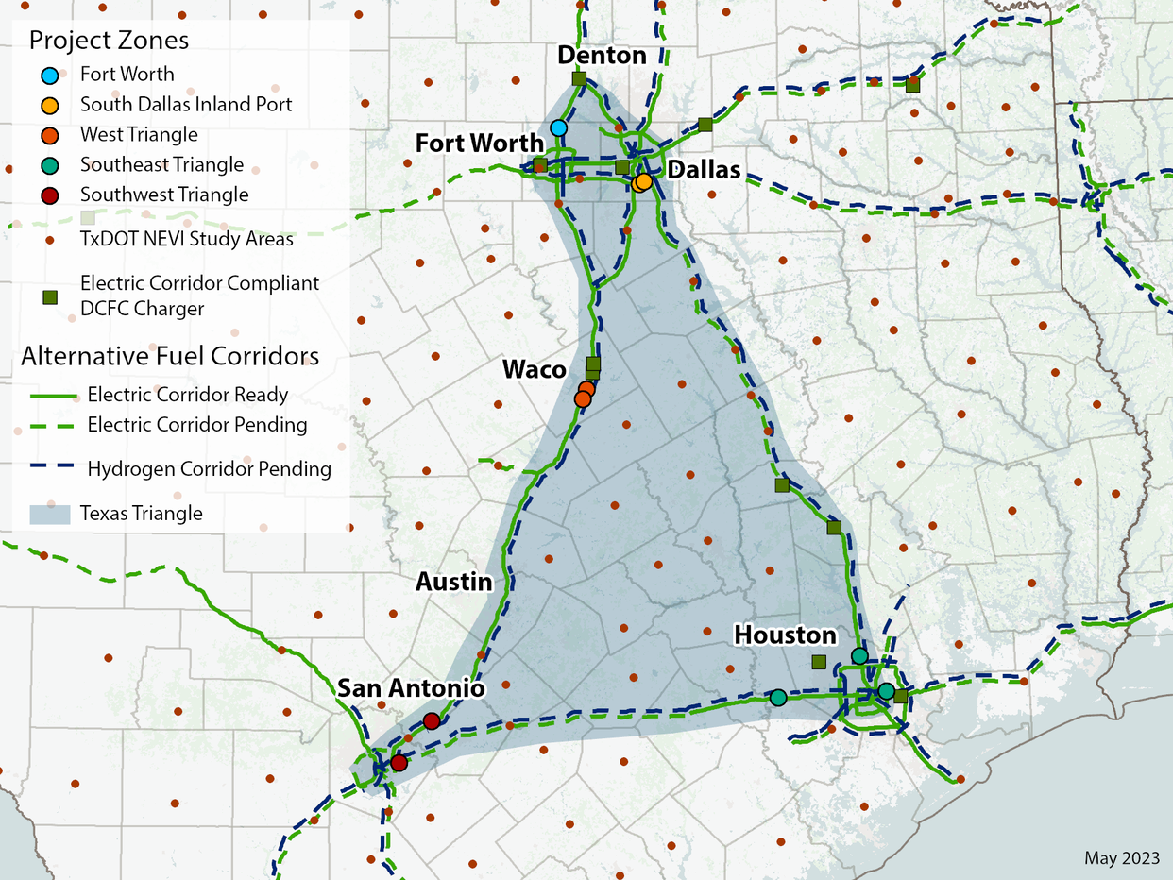
CFI Corridor Program: Proposal
Hydrogen refueling for up to 5 stations (zones) around Texas Triangle
Project Zones
Fort Worth Zone –
Alliance Texas Global Logistics Hub
Dallas Zone –
Southern Dallas County Inland Port
Southeast Triangle Zone – Houston
Southwest Triangle Zone – San Antonio
West Triangle Zone - Waco
Submitted proposal for $70 Million
on June 13

Slide 28
CFI Community Program: Approach and Proposal
Apply on behalf of the region for funding
Build EV charging stations to provide up
to 100 charging ports regionwide
At least 50% in Justice40 Areas
Emphasizing Focus Areas
Create specialized technical teams to streamline project implementation
Zoning, permitting, codes, Buy America, NEPA
Submitted proposal for maximum award
of $15 Million on June 13

Slide 29
Climate Pollution Reduction Grants
Created by Section 60114 of the Inflation Reduction Act
Purpose: Develop and implement plans for reducing greenhouse gas emissions (GHG) and other harmful air pollutants
Will be administered by the Environmental Protection Agency (EPA) in two phases:
Phase 1: $250 Million Non-Competitive Planning Grants
Phase 2: $4.6 Billion in Competitive Implementation Grants
https://www.epa.gov/inflation-reduction-act/climate-pollution-reduction-grants
EV Infrastructure Planning & Economic Development
Notes:
To be eligible for implementation must participate in planning
Simple Payback: calculates the length of time required to recover the cost of purchasing a new AFV, as compared to its conventional counterpart & estimates annual petroleum use, GHGs, and air pollutant emissions.
Total Cost of Ownership: calculates the total cost (operating & fixed), in today’s dollars, of owning a new vehicle over its lifetime & estimates lifetime petroleum use, GHGs, and air pollutant emissions
Fleet Footprint: estimates the annual petroleum use, GHGs, and air pollutant emissions of existing and new vehicles in a fleet.

Slide 30
Phase 1: Planning Grants
$1 million is available for the Dallas-Fort Worth (DFW)-Arlington metropolitan statistical area (MSA)
NCTCOG is the lead organization on behalf of the DFW-Arlington MSA
Responsible for oversight for managing grant funds
Coordinate activities and deliverables pertaining to the grant
Includes Wise, Denton, Collin, Parker, Tarrant, Dallas, Rockwall, Kaufman, Ellis, Johnson, and Hunt counties
Inclusion of neighboring jurisdictions, outside the boundary lines of the MSA, is allowed and encouraged
$3 million to each State, DC, and Puerto Rico
Texas chose to receive planning funds
To be eligible to apply for Phase 2 Implementation funding, entities and proposed projects must be covered by either a State or MSA Phase 1 planning grant
EV Infrastructure Planning & Economic Development
Notes:
Simple Payback: calculates the length of time required to recover the cost of purchasing a new AFV, as compared to its conventional counterpart & estimates annual petroleum use, GHGs, and air pollutant emissions.
Total Cost of Ownership: calculates the total cost (operating & fixed), in today’s dollars, of owning a new vehicle over its lifetime & estimates lifetime petroleum use, GHGs, and air pollutant emissions
Fleet Footprint: estimates the annual petroleum use, GHGs, and air pollutant emissions of existing and new vehicles in a fleet.

Slide 31
Phase 1 Deliverables - Planning Grants
Deliverable #1: Priority Climate Action Plan (PCAP) – March 1, 2024
GHG inventory and quantified GHG reduction measures
Low-income and disadvantaged communities’ benefits analysis
Review of authority to implement
Deliverable #2: Comprehensive Climate Action Plan (CCAP) – Summer 2025
GHG emissions projections, reduction targets, and reduction measures
Benefits analysis for full geographic scope and population covered by the plan
Low-income communities benefit and workforce analysis
Plan to leverage other federal funding
Deliverable #3: Final Report – Summer 2027
Report on progress towards GHG reduction and next steps
EV Infrastructure Planning & Economic Development
Notes:
Simple Payback: calculates the length of time required to recover the cost of purchasing a new AFV, as compared to its conventional counterpart & estimates annual petroleum use, GHGs, and air pollutant emissions.
Total Cost of Ownership: calculates the total cost (operating & fixed), in today’s dollars, of owning a new vehicle over its lifetime & estimates lifetime petroleum use, GHGs, and air pollutant emissions
Fleet Footprint: estimates the annual petroleum use, GHGs, and air pollutant emissions of existing and new vehicles in a fleet.

Slide 32
Next Steps - Planning Grants
Development of the Dallas-Fort Worth (DFW) Climate Action Plan (CAP) will begin in Summer 2023
NCTCOG will host a working group of local governments to develop the DFW CAP
Information about the CPRG Implementation Grants will be released in Summer 2023
Local governments interested in participating in the development of the DFW CAP should contact Savana Nance at snance@nctcog.org
Additional details are available at www.PublicInput.com/nctcog-cprg
EV Infrastructure Planning & Economic Development
Notes:
Simple Payback: calculates the length of time required to recover the cost of purchasing a new AFV, as compared to its conventional counterpart & estimates annual petroleum use, GHGs, and air pollutant emissions.
Total Cost of Ownership: calculates the total cost (operating & fixed), in today’s dollars, of owning a new vehicle over its lifetime & estimates lifetime petroleum use, GHGs, and air pollutant emissions
Fleet Footprint: estimates the annual petroleum use, GHGs, and air pollutant emissions of existing and new vehicles in a fleet.

Slide 33
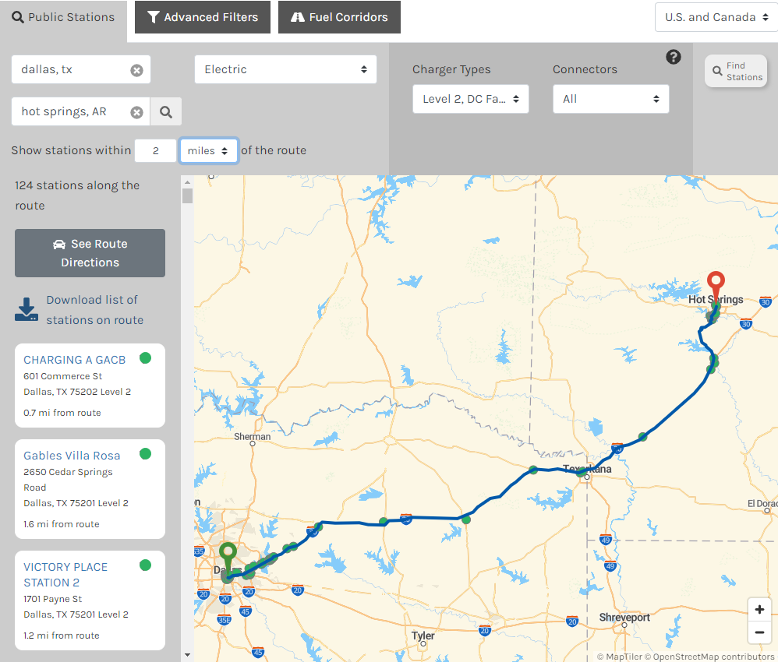
Charging As A Destination
Road trip anyone? Will your town be ready?
EV drivers plan ahead for their charging
needs and are looking for fun things to
do while charging!
Break for 30 minutes to 2 hours – DCFC
Restaurants, movie, shopping, parks, rest stops,
sports stadiums, museums, etc.
Walking distance from charger
Level 2 chargers work for a lot of these examples
Overnight – Level 2 Charger
Hotels, campgrounds
EV Infrastructure Planning & Economic Development
Notes:
Simple Payback: calculates the length of time required to recover the cost of purchasing a new AFV, as compared to its conventional counterpart & estimates annual petroleum use, GHGs, and air pollutant emissions.
Total Cost of Ownership: calculates the total cost (operating & fixed), in today’s dollars, of owning a new vehicle over its lifetime & estimates lifetime petroleum use, GHGs, and air pollutant emissions
Fleet Footprint: estimates the annual petroleum use, GHGs, and air pollutant emissions of existing and new vehicles in a fleet.

Slide 34
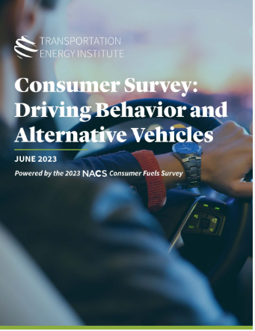
Charging As A Destination Resources
EV Destination Charging | Consumer Avenue (transportationenergy.org)
Reports (transportationenergy.org) The Transportation Energy
Institute is a non-advocacy research organization dedicated to studying
transportation-energy.
Rural EV Infrastructure Toolkit – one-stop resource to help rural
communities scope, plan, and identify ways to fund EV-charging infrastructure
Leveraging EV Charging Infrastructure to Make Your Community a Destination – YouTube
Alternative Fuels Data Center: Alternative Fueling Station Locator (energy.gov)
EV Infrastructure Planning & Economic Development
Notes:
Simple Payback: calculates the length of time required to recover the cost of purchasing a new AFV, as compared to its conventional counterpart & estimates annual petroleum use, GHGs, and air pollutant emissions.
Total Cost of Ownership: calculates the total cost (operating & fixed), in today’s dollars, of owning a new vehicle over its lifetime & estimates lifetime petroleum use, GHGs, and air pollutant emissions
Fleet Footprint: estimates the annual petroleum use, GHGs, and air pollutant emissions of existing and new vehicles in a fleet.

Slide 35
EV Infrastructure Workforce Needs
Increased demand for EV infrastructure electricians and technicians anticipated
Availability and reliability requires adequate local workforce
Deployment
Ongoing maintenance
Opportunity for local community colleges
Training - Electric Vehicle Infrastructure Training Program (EVITP) certification
Must be a state licensed or certified electrician
Technical installation curriculum
Developed in collaboration with industry
EV Infrastructure Planning & Economic Development
Notes:
Simple Payback: calculates the length of time required to recover the cost of purchasing a new AFV, as compared to its conventional counterpart & estimates annual petroleum use, GHGs, and air pollutant emissions.
Total Cost of Ownership: calculates the total cost (operating & fixed), in today’s dollars, of owning a new vehicle over its lifetime & estimates lifetime petroleum use, GHGs, and air pollutant emissions
Fleet Footprint: estimates the annual petroleum use, GHGs, and air pollutant emissions of existing and new vehicles in a fleet.

Slide 36
Funding for Vehicles and Infrastructure
www.nctcog.org/aqfunding
Program/Incentive | Eligible Activities | Funding Amount | Deadline to Apply
Alternative Fuel Infrastructure Tax Credit | Purchase of qualified residential fueling equipment, such as EV charging infrastructure | Up to $1,000 tax credit | December 31, 2032
Electric Vehicle (EV) and Fuel Cell Electric Vehicle (FCEV) Tax Credit* | New EV, PHEV, or FCEV with a GVWR of 14,000 lbs. or less with final assembly in North America | $2,500 - $7,500 tax credit | No Deadline
Previously Owned Clean Vehicle Credit* | Used EV, PHEV, or FCEV with a GVWR of 14,000 lbs. or less | Up to $4,000 tax credit | No Deadline
Light-Duty Motor Vehicle Purchase or Lease Incentive Program* | New purchase or lease of a light-duty EV, PHEV, or FCEV | Up to $2,500 | Available on a first-come, first-served basis starting September 1 of each odd-numbered year
GreenSense Incentive Program* for Denton Municipal Electric (DME) customers | EVs and PHEVs | $300 | No Deadline
United Cooperative Services Rebates for United Cooperative Services customers | Electric vehicle charger | 50% up to $500 on a Level 2 (240 Volt) EV charger | End of 2023 or until funds are depleted
EV Infrastructure Planning & Economic Development
Notes:
Simple Payback: calculates the length of time required to recover the cost of purchasing a new AFV, as compared to its conventional counterpart & estimates annual petroleum use, GHGs, and air pollutant emissions.
Total Cost of Ownership: calculates the total cost (operating & fixed), in today’s dollars, of owning a new vehicle over its lifetime & estimates lifetime petroleum use, GHGs, and air pollutant emissions
Fleet Footprint: estimates the annual petroleum use, GHGs, and air pollutant emissions of existing and new vehicles in a fleet.

Slide 37
Funding for Infrastructure
Funding Agency | Program | Typical Schedule | Eligible Applicants | Eligible Activities | Eligible Funding Levels
USDA | Rural Business Development Grants | Closed- Anticipated Opening Spring 2023 | State and local governmental authorities, federally recognized tribes, nonprofit corporations, institutions of higher education, and rural cooperatives (if organized as a nonprofit corporation). | EV charging stations can be funded through this grant if local small businesses can provide Letters of Support that state the charging stations will support job growth/retention | There is no maximum grant amount; however, smaller requests are given higher priority. There is no cost sharing requirement. Opportunity grants are limited to up to 10 percent of the total Rural Business Development Grant annual funding.
TCEQ | TERP Alternative Fueling Facilities Program | Closed; Expected Summer 2024 | Public or private entities/individuals | Funds new construction or the expansion of existing alternative or natural gas fueling facilities | Up to $400,000 for a compressed natural gas CNG or LNG project Up to $600,000 for a combined CNG and LNG project Up to 50% or maximum of $600,000, whichever is less, for fuels other than natural gas
www.nctcog.org/aqfunding
EV Infrastructure Planning & Economic Development
Notes:
Simple Payback: calculates the length of time required to recover the cost of purchasing a new AFV, as compared to its conventional counterpart & estimates annual petroleum use, GHGs, and air pollutant emissions.
Total Cost of Ownership: calculates the total cost (operating & fixed), in today’s dollars, of owning a new vehicle over its lifetime & estimates lifetime petroleum use, GHGs, and air pollutant emissions
Fleet Footprint: estimates the annual petroleum use, GHGs, and air pollutant emissions of existing and new vehicles in a fleet.

Slide 38
Upcoming Projects Through US Department of Energy
Develop & deploy EV charging station maintenance training curriculum to support NEVI implementation
NCTCOG Role: Replicate EV technician training developed by Louisiana’s Clean Cities Coalition in the DFW area, in collaboration w/community colleges & will coordinate w/Workforce
ZEV infrastructure plan along Texas Triangle & Interstate 10 Corridor - hydrogen
NCTCOG Role: Support planning and stakeholder convening, ensure local needs integrated into plan
Develop & deploy designation program to recognize cities that implement EV-friendly processes/rules
NCTCOG Role: Guide local govts to establish best practices as set by a national designation/recognition program and receive the designation/recognition
Demonstrate electric/autonomous multimodal (UAS/delivery bot/surface vehicle) first- and last-mile deliveries to address demonstrated needs in ZIP code 76010
NCTCOG Role: Assist in developing and evaluating performance metrics; guide development of best practice/replication guide and identify how successful projects can be replicated/scaled up beyond Arlington to the regional level
38

Slide 39
Contact Us
Lori Clark
Senior Program Manager &
DFWCC Director
lclark@nctcog.org
Amy Hodges
Principal Air Quality Planner
ahodges@nctcog.org
dfwcleancities.org
cleancities@nctcog.org

